Slide 1
Investigating Global and National Sustainable Energy Transition Paths
Dénes Csala
PhD Qualifying Exam Part 2
Masdar Institute | MIT | 10/08/15
20 trillion green watts

Slide 2
20 trillion green watts
Notes:
Wealthy countries could afford to do that because of fossil fuels. 2 problems with that. Depletion and global warming.

Slide 3
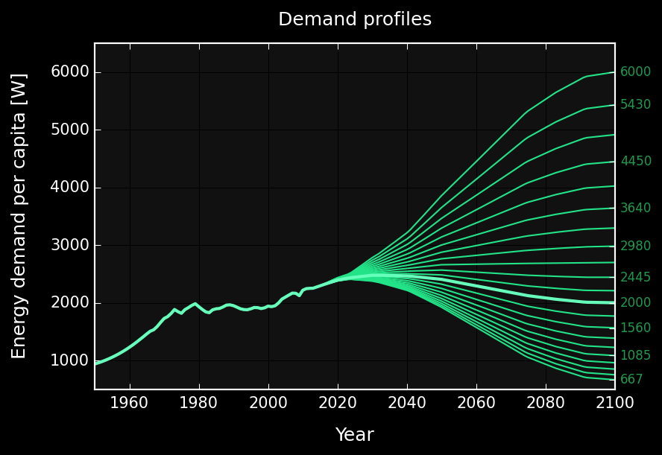
2000 W / capita ∙ 10 billion people = 20 trillion W
Pickard (2014)
Trainer (2014)
Spreng (2005)
Project Novatlantis (2004)
Marechal et al. (2005)
Jacobson , Delucchi (2011)
MIT SOLVE (2015)
An average net primary power of 2000W per capita may be considered as a lower limit for maintaining an acceptable quality of life in a technical society.
Marechal et al. (2005), Pfeiffer et al. (2005),
Spreng (2005), Schultz et al. (2008), Huebner (2009)
GRAPH: Own work based on open energy data from EIA (1970-2040), BP (1960-2035), population data from UNSD, (1950-2100)

Slide 4
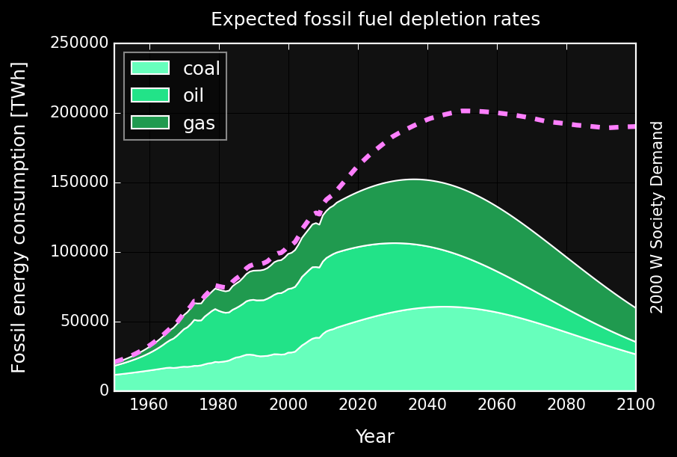
IPCC AR5 WG1 RCP2.6
Carbon budget*
990 GtCO₂
[510 – 1505]
2032
[2020-2045]
GRAPH: Own work based on open energy data from EIA (1970-2040), BP (1960-2035), population data from UNSD, (1950-2100)
Maggio, Cacciola (2012), Mohr et al. (2015)
* Fossil fuels, industrial processes (including cement) and waste
Notes:
Wealthy countries could afford to do that because of fossil fuels. 2 problems with that. Depletion and global warming.
Potential reserves exceed the co budget by 35-60 times (6-7 proven reserves)

Slide 5
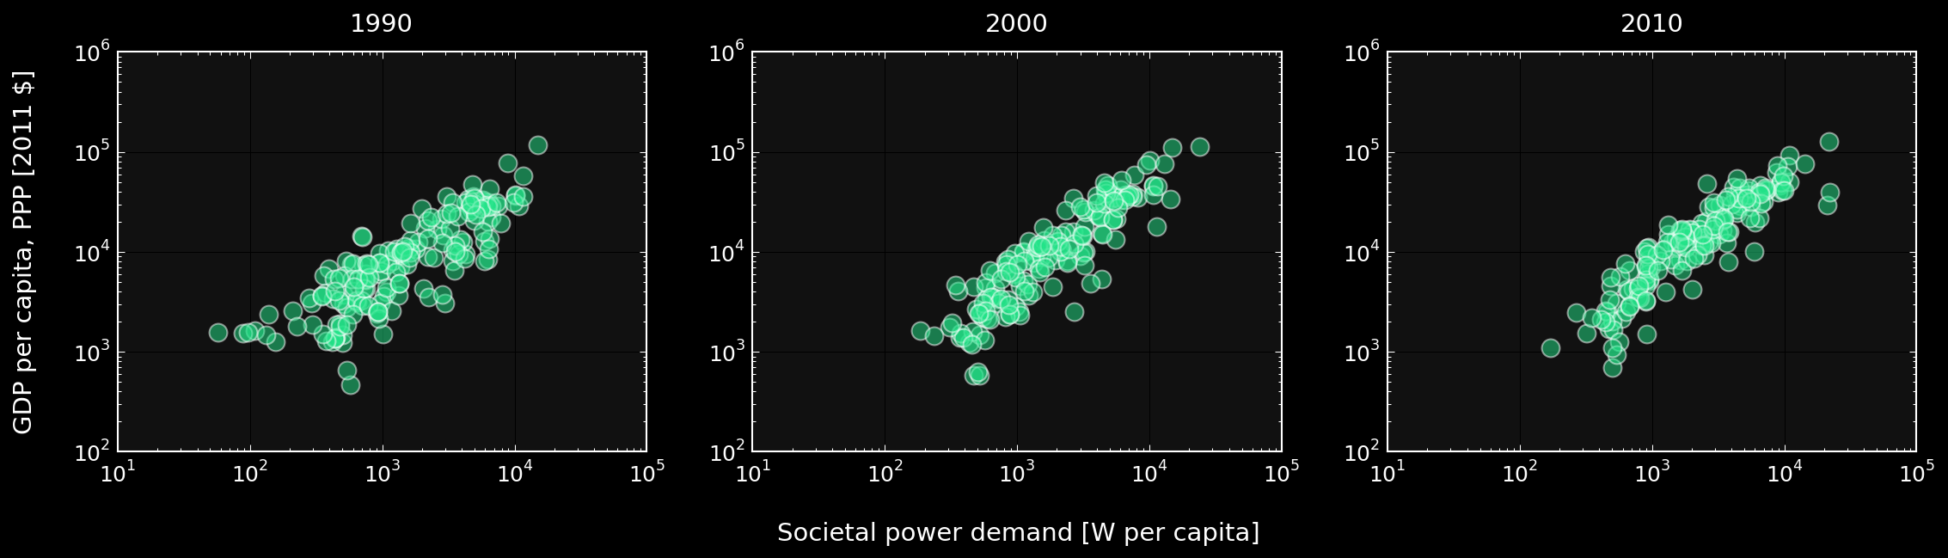
“Massive reductions in OECD countries would perhaps even leave room in the global CO₂-emission budget to allow poverty eradication as stipulated in the UN millennium goals without triggering catastrophic climate change.”
sustainable development
Spreng (2005)
GRAPH: Own work based on open energy and GDP data from World Bank (1990-2010)
Notes:
Wealthy countries could afford to do that because of fossil fuels. 2 problems with that. Depletion and global warming.

Slide 6
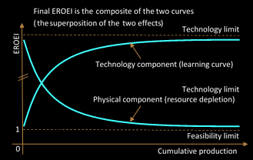
Energy Return on Energy Invested = EROEI
Solar PV 5 – 15
Wind 20 – 40
Solar CSP 10 – 20
Geothermal 15 – 35
Oil 25 – 10 [60 – 40]
Gas 25 – 15 [60 – 40]
Coal 50 – 15 [100 – 80]
Barnhart, Dale et al. (2013), Klemes (2015), Hall (2014)
King, Hall (2011), Gupta (2011), Moerschbaecher (2011), Kubiszewski (2010)
GRAPH: Own work based on Dale, Krumdieck (2012)
Notes:
Wealthy countries could afford to do that because of fossil fuels. 2 problems with that. Depletion and global warming.

Slide 7
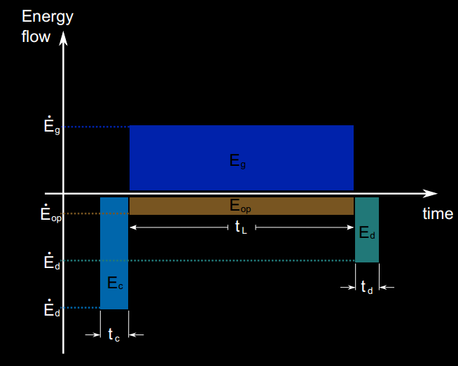
OPEX vs. CAPEX nature of Energy Investment
Fossil
Renewable
E_{op}
GRAPH: Murphy et al. (2011) and own work based on Murphy et al. (2011)
Notes:
Wealthy countries could afford to do that because of fossil fuels. 2 problems with that. Depletion and global warming.

Slide 8
sustainable energy transition

Slide 9
sustainable energy transition
The impacts from energy use during SET should not exceed the long-run ecosystem carrying and assimilation capacity.
Per capita net available energy should remain above a level that satisfies societal needs at any point during SET and without disruptive discontinuities in its rate of change.
The rate of investment in building renewable energy harvesting and utilization capital stock should be sufficient to create a sustainable energy supply basis before the non-renewable safely recoverable resources are exhausted.
Daly (1996), Sgouridis, Csala (2014), Sgouridis, Bardi, Csala (under review)
Notes:
Wealthy countries could afford to do that because of fossil fuels. 2 problems with that. Depletion and global warming.

Slide 10
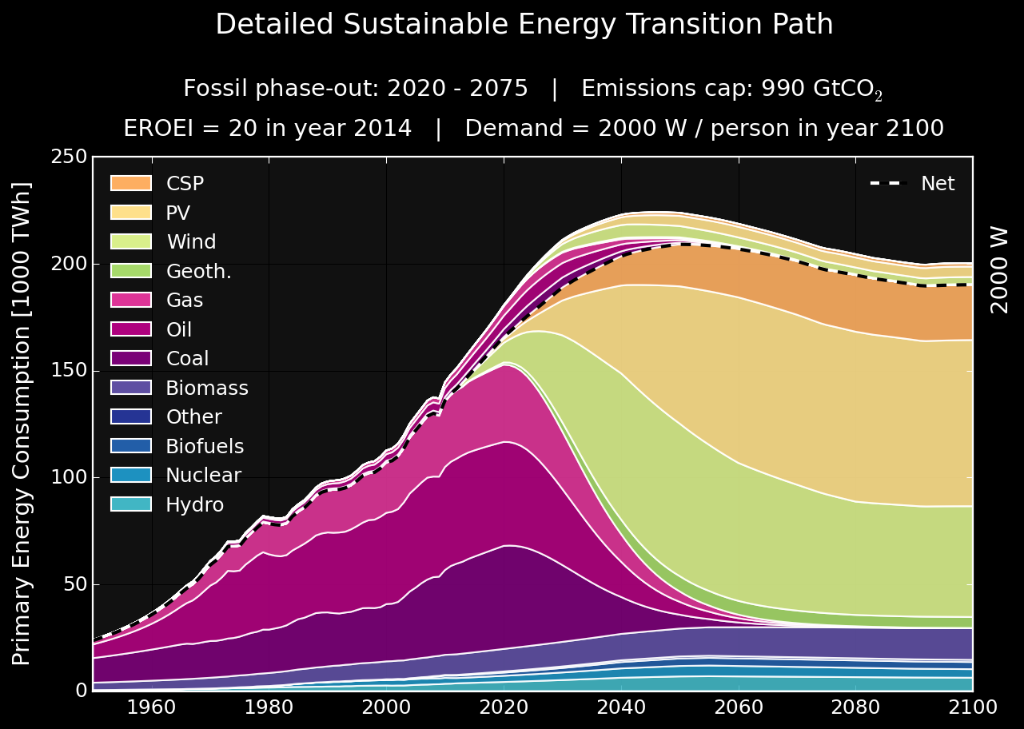
√ Carrying capacity
√ Societal needs
√ Sustainable investment
Sgouridis, Bardi, Csala (expected 2015)
GRAPH: Own work based on the principles outlined by Sgouridis, Csala (2014) using open data from EIA, BP, UNSD
Notes:
Wealthy countries could afford to do that because of fossil fuels. 2 problems with that. Depletion and global warming.

Slide 11
research questions

Slide 12


research questions
What is the feasibility of a global sustainable energy transition?
If possible, what level of economic and social effort is necessary to achieve it?
(transition scale, timeline, options, trade-offs)
What are the feasibilities of sustainable energy transitions for individual nations?
If possible how is the national sustainable energy transition affected by:
Natural energy resources (fossil reserves and renewable potential)
Embedded energy resources (energetic and economic trade flows)
completed
to be addressed
Notes:
Wealthy countries could afford to do that because of fossil fuels. 2 problems with that. Depletion and global warming.

Slide 13
methodology

Slide 14
methodology
Trade
data
[UN COMTRADE]
Renewable
EROEI
[Literature]
Sustainable Energy Transition Paths
Population projections
[UNSD]
Renewable energy data
Transition Feasibility Index
Demand data
Demand projections
[Literature]
Most Feasible Paths
Fossil
data
Renewable potential
[IRENA]
Emissions data
[IPCC, EIA, BP]
A data-driven, automated creation of feasible sustainable
energy transition paths for the globe and all nations

Slide 15



methods
$P_{M}$ - peak production, $t_{M}$ - peak year, $U$ – ultimately recoverable reserves
Forced Hubbert phase-out
Demand projections
[Literature]
Hubbert curve multi-variant
Fossil
data
Emissions data
[IPCC, EIA, BP]
$$P_{M},t_{M}$$
well-defined
U limited by carbon cap!
Maggio, Cacciola (2012)
Notes:
Most of the modeling is being conducted by developing – mostly economically ratified scenarios – and then assessing the impact later.
We decided to go the other way around and investigate only the scenarios which fit into the co2 limit by design.

Slide 16
methods
$P_{M}$ - peak production, $t_{M}$ - peak year, $U$ – ultimately recoverable reserves
Distributing fossil sources within U
Distributing the global U amongst nations
Production-based
2C Compliant Extractable Reserves
Consumption-based
Population, GDP, Fossil Reserves, “High Emitters”, Emissions Trading, Carbon Price ?, COP21 ?
Forced Hubbert phase-out
Demand projections
[Literature]
Fossil
data
Emissions data
[IPCC, EIA, BP]
$$P_{M},t_{M}$$
well-defined
U limited by carbon cap!
US = OECD – US = China = Non-OECD - China
Chakravarty, Pacala, Socolow (2009), Davis, Caldeira (2009), Maggio, Cacciola (2012), Sgouridis (2015)
Notes:
Distribution hasn’t been done yet – so we will use a weighted version
If production based distribution – who gets to get the oil from where
If consumption based who gets to consume when
Start by per capita emissions distributed equally, but then bring in gdp – and the unequal distribution of wealth, as well as the existing energy mixes of countries
Take away the emissions quotas of the 3 billion poorest and add it to the 1 billion wealthiest – not forgetting that per capita emission grows by gdp, but only because the country generation mixes – indirectly accounting for the fact the those respective countries got rich on cheaply available fossil fuels
DDPP – simple per capita distribution

Slide 17



methods
$$I_{renewable}=\frac{d}{dt}C_{ren}+\frac{1}{c}\int_{t−L}^{t}{I_{renewable}}$$
Renewable
EROEI
[Literature]
Population projections
[UNSD]
Renewable energy data
Demand data
Demand projections
[Literature]
Fossil
data
Emissions data
[IPCC, EIA, BP]
Own work for Sgouridis, Bardi, Csala (under review)

Slide 18
methods
Trade
data
[UN COMTRADE]
Renewable
EROEI
[Literature]
Sustainable Energy Transition Paths
Population projections
[UNSD]
Renewable energy data
Demand data
Demand projections
[Literature]
Fossil
data
Renewable potential
[IRENA]
Emissions data
[IPCC, EIA, BP]
Own work for Sgouridis, Bardi, Csala (under review)

Slide 19
methods
Trade
data
[UN COMTRADE]
Sustainable Energy Transition Paths
under
construction
Renewable energy data
For countries
Renewable potential
[IRENA]
Own work for Sgouridis, Bardi, Csala (under review)

Slide 20
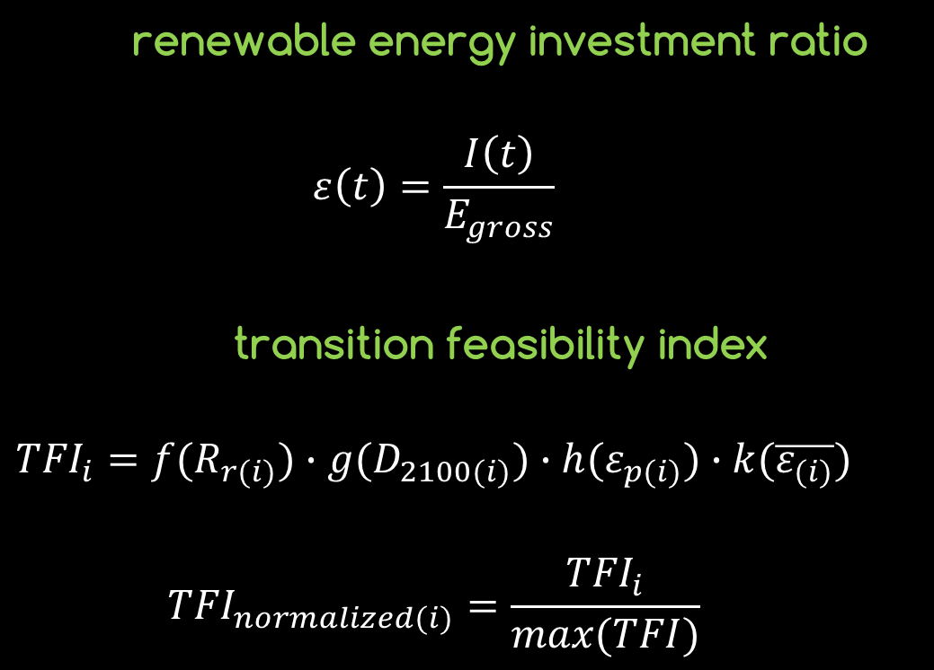
methods
Trade
data
[UN COMTRADE]
renewable energy investment ratio
$$ε\left(t\right)=\frac{I\left(t\right)}{E_{gross}}$$
transition feasibility index
$${TFI}_{i}=f(R_{r(i)})∙g(D_{2100(i)})∙h(ε_{p(i)})∙k(\overline{ε_{(i)}})$$
$${TFI}_{normalized(i)}=\frac{{TFI}_{i}}{max⁡(TFI)}$$
Sustainable Energy Transition Paths
Renewable energy data
Transition Feasibility Index
Most Feasible Paths
Renewable potential
[IRENA]
Own work for Sgouridis, Bardi, Csala (under review)

Slide 21
results

Slide 22
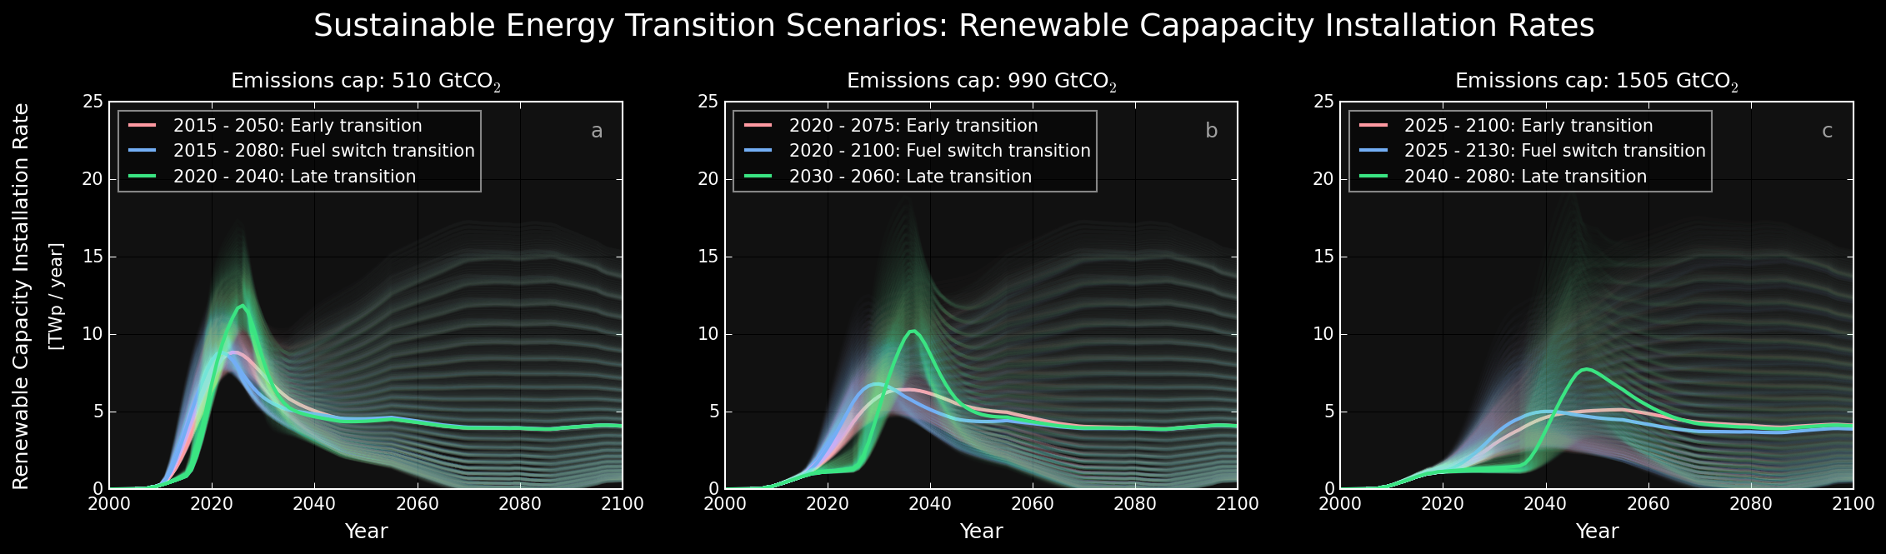
results
EROEI₂₀₁₄ range: 6.67 … 20 ... 60 Demand₂₁₀₀ range: 667 … 2000 ... 6000 [Wp/cap]
Sgouridis, Bardi, Csala (under review)
GRAPH: Own work based on the principles outlined by Sgouridis, Csala (2014) using open data from EIA, BP, UNSD
Notes:
Ange includes all possible scenarios expected by the literature

Slide 23
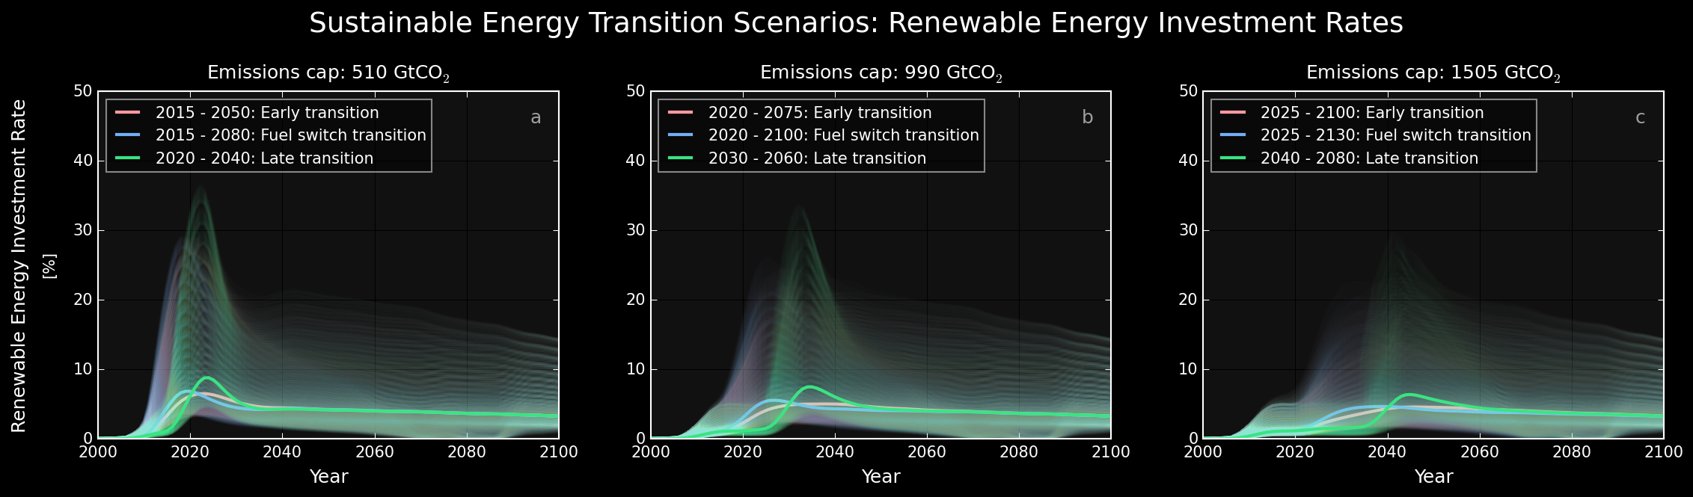
results
Sgouridis, Bardi, Csala (under review)
GRAPH: Own work based on the principles outlined by Sgouridis, Csala (2014) using open data from EIA, BP, UNSD
Notes:
Wealthy countries could afford to do that because of fossil fuels. 2 problems with that. Depletion and global warming.

Slide 24
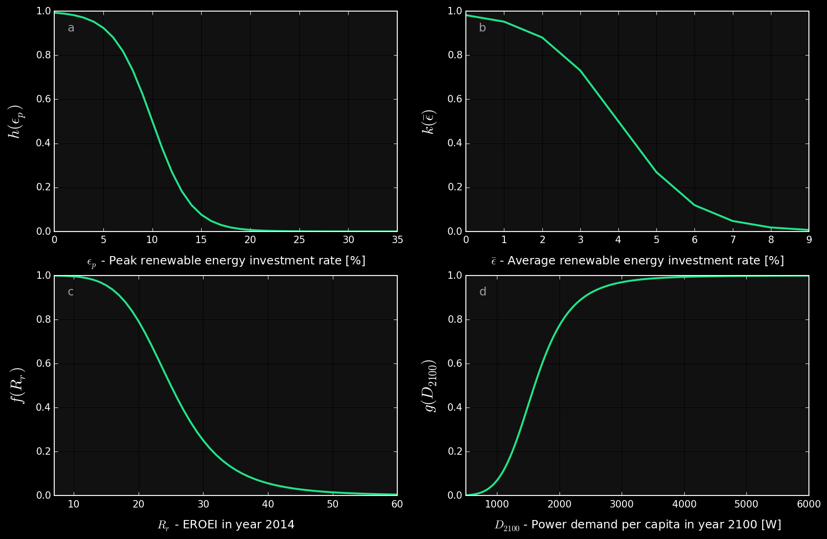
results
Sgouridis, Bardi, Csala (under review)
GRAPH: Own work given the expected values of variables in the literature and physical constraints
Notes:
Wealthy countries could afford to do that because of fossil fuels. 2 problems with that. Depletion and global warming.

Slide 25
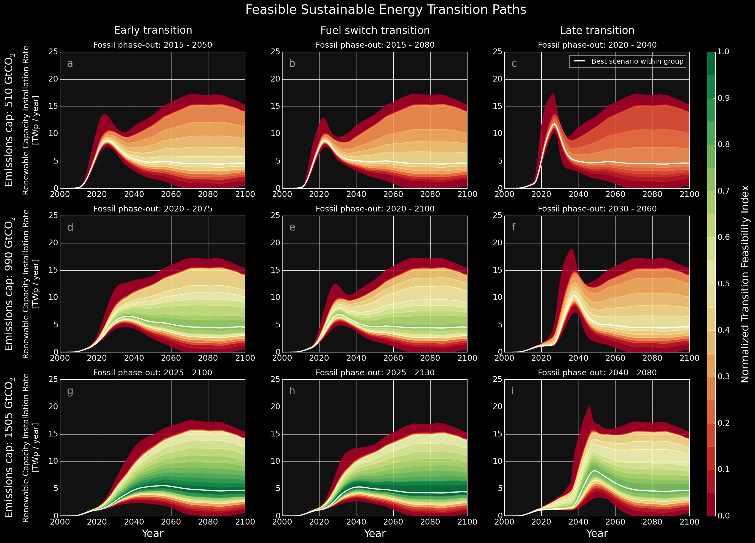
results
The transition envelopes are narrow during the early transition phase
Hitting the feasible region requires a 36 times increase in renewable energy installation rates within two decades
Sgouridis, Bardi, Csala (under review)
GRAPH: Own work
Notes:
Wealthy countries could afford to do that because of fossil fuels. 2 problems with that. Depletion and global warming.

Slide 26
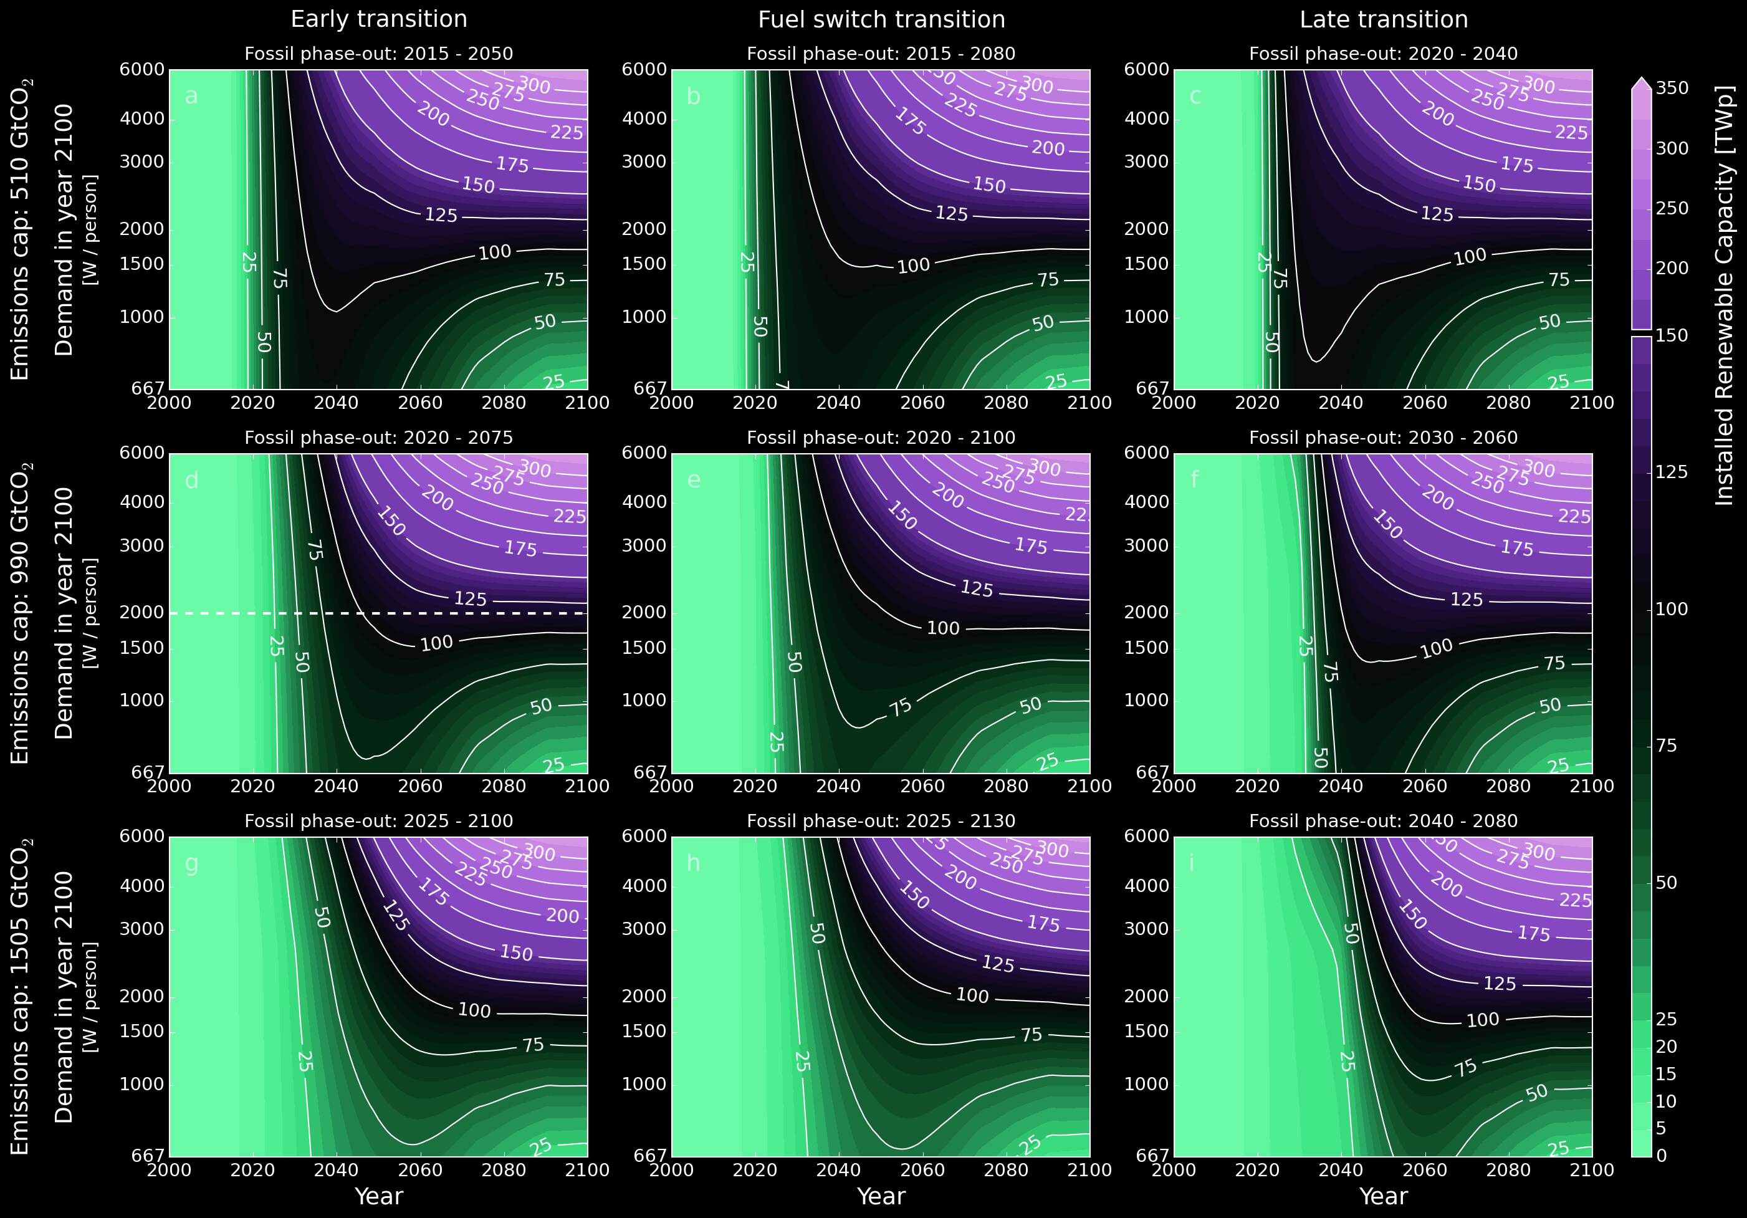
results
majority of additional capacity needs to be added before 2040
this holds even with very small final demand
transition speed critical
Sgouridis, Bardi, Csala (under review)
GRAPH: Own work
Notes:
Wealthy countries could afford to do that because of fossil fuels. 2 problems with that. Depletion and global warming.

Slide 27
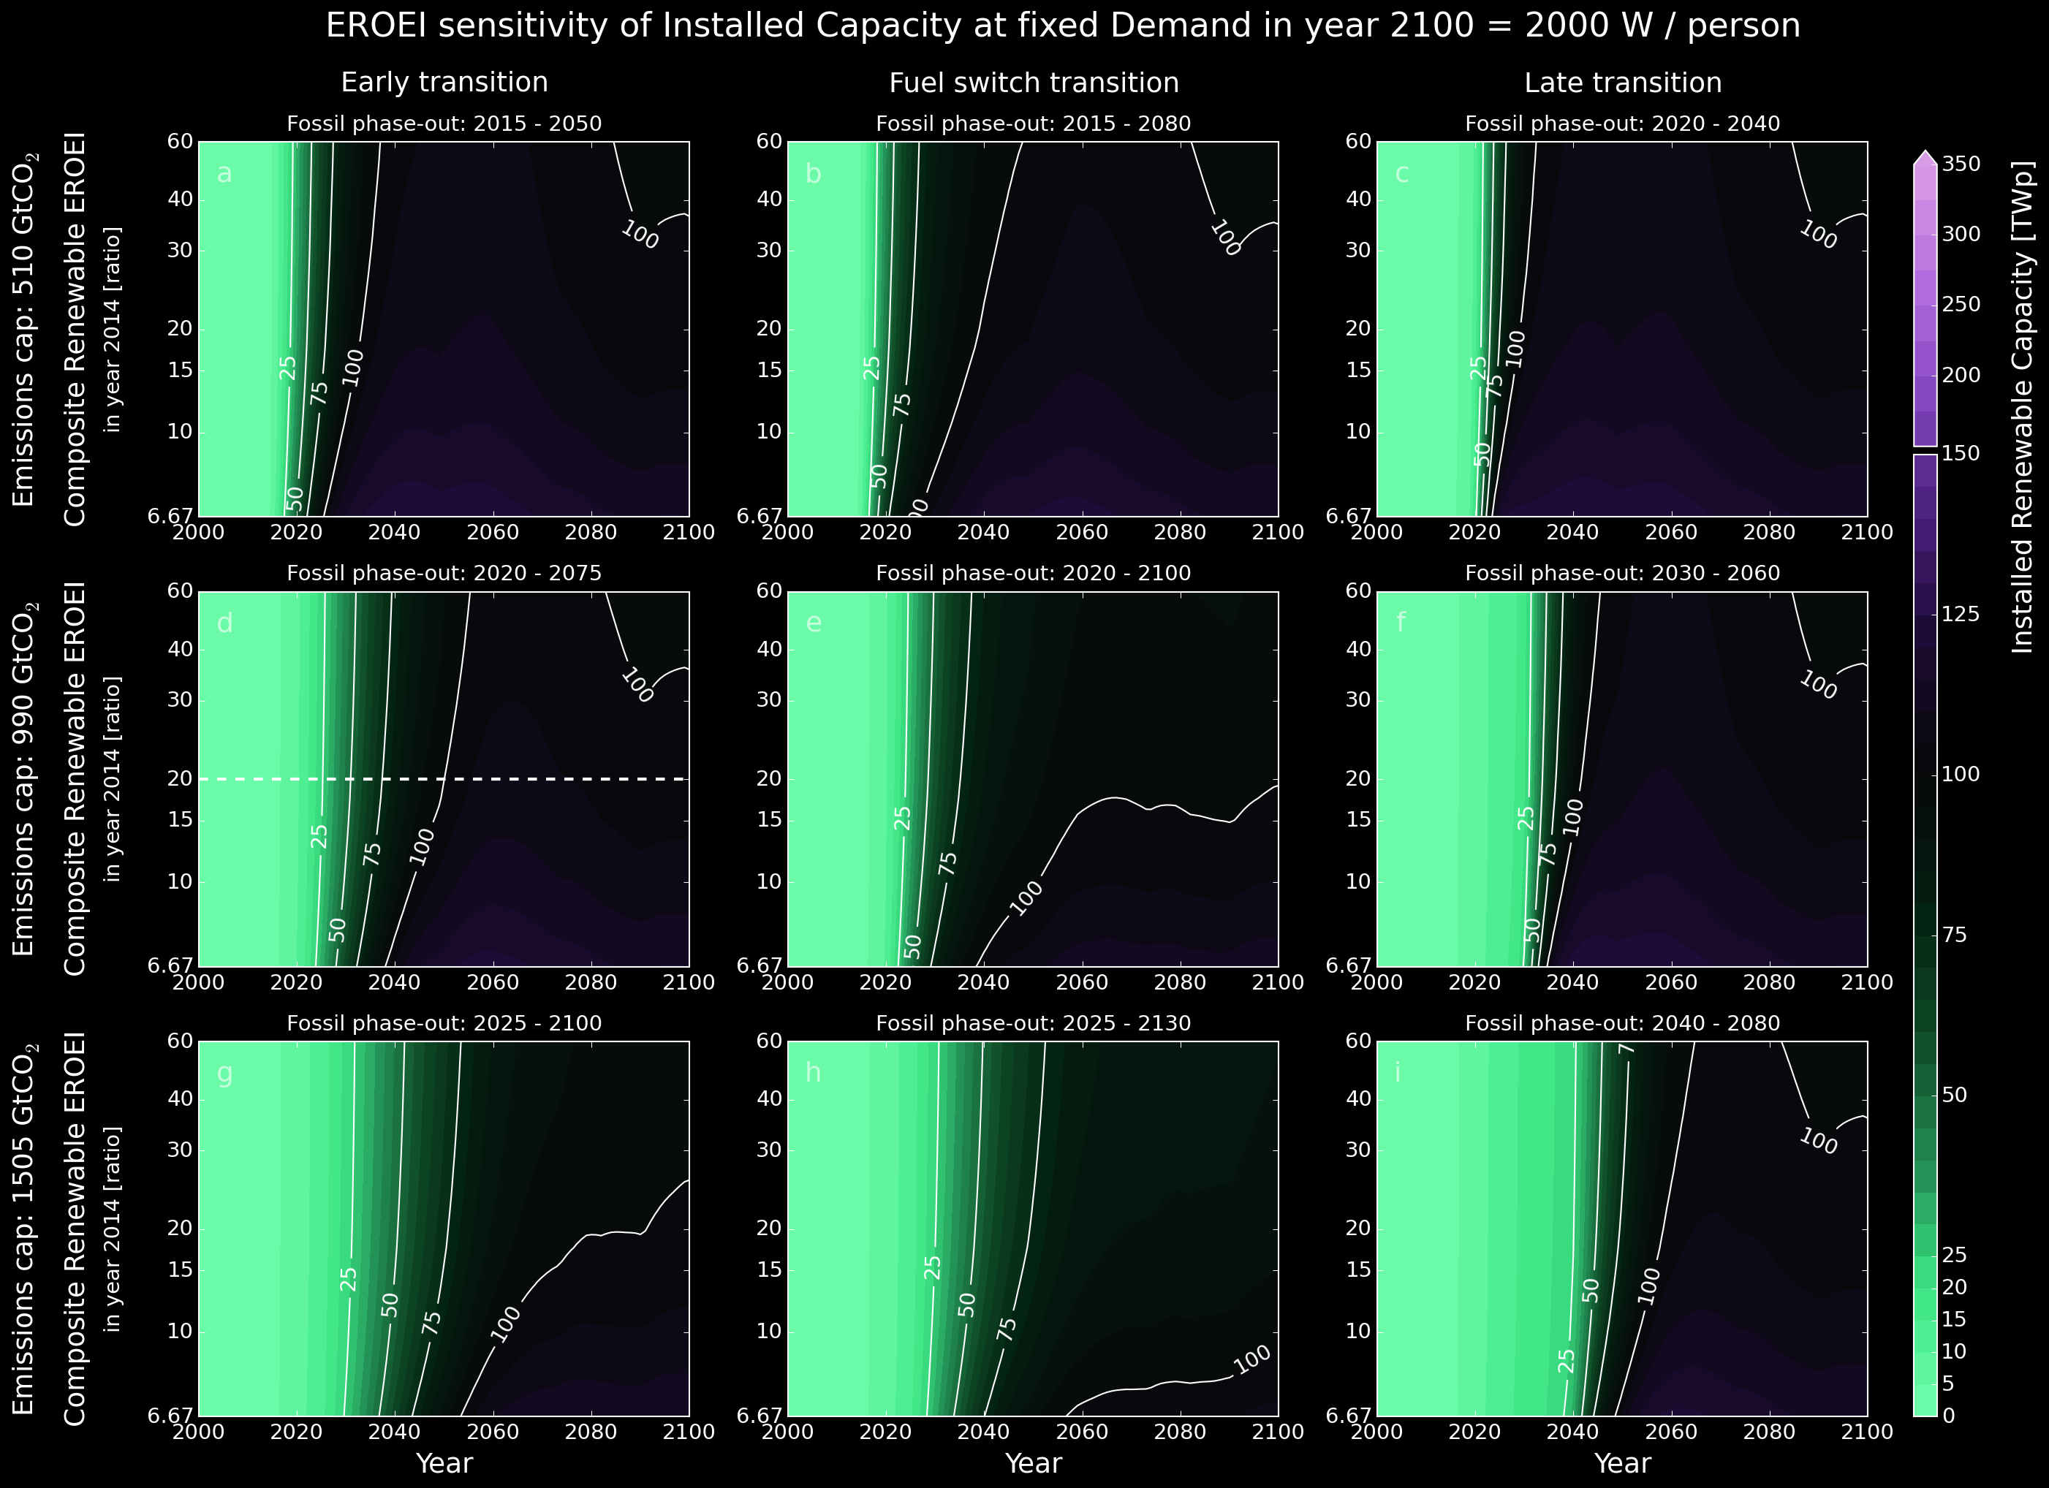
results
smaller sensitivity to EROEI
EROEI only becomes prohibitive if very low
Sgouridis, Bardi, Csala (under review)
GRAPH: Own work
Notes:
Wealthy countries could afford to do that because of fossil fuels. 2 problems with that. Depletion and global warming.

Slide 28
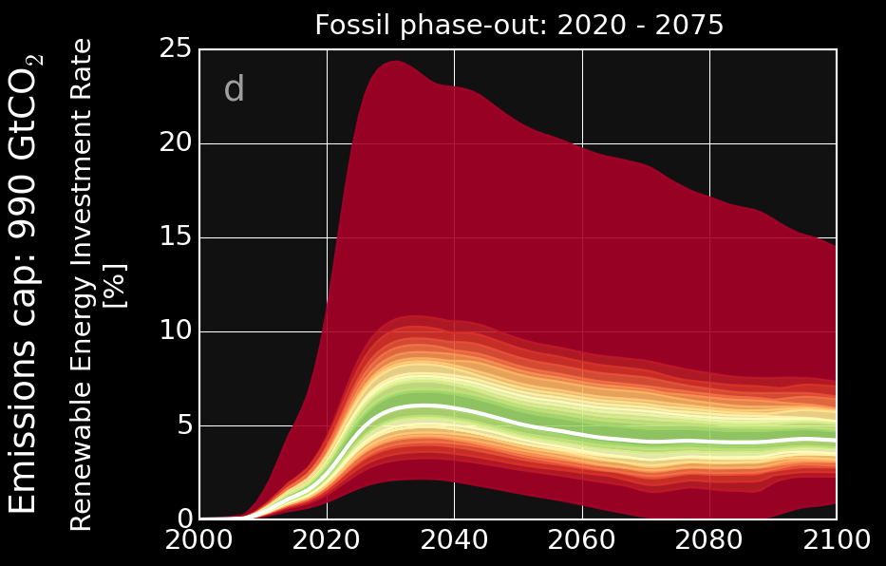
Comparison with DDPP by SDSN
By 2050 minus 57% CO₂ compared to 2010, share of electricity doubles in final energy mix
Annual investments in low-carbon technologies
[monetary, % GDP]:
2020 | 2030 | 2040 | 2050
0.8 | 1.2 | 1.3 | 1.3
DDPP Executive Summary (2015), Sgouridis, Bardi, Csala (under review)
GRAPH: Own work
Notes:
IEA, EIA, BP, Shell: above 4 degrees trajectory – and they keep saying that!
According to NASA, 2 degrees results in 6 metres of sea-level rise!
DDPP: -57% compared to 2010, 3.1% GDP growth
The state that they include technology learning but not clear how
Do not actually state clearly the primary energy requirements and fossil consumption of countries
They only report carbon intensity or power generation – they do not give the breakdowns…
Quadrupling building efficiency

Slide 29
progress

Slide 30
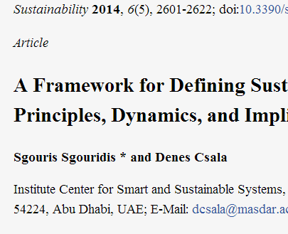
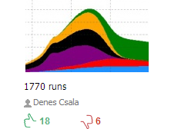
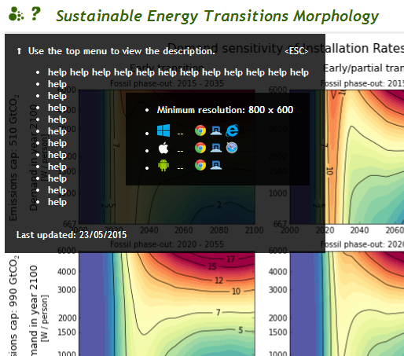
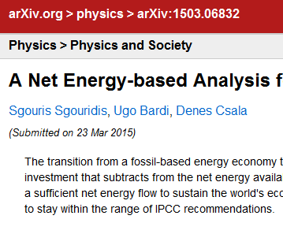
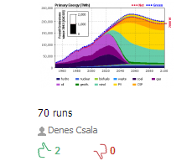
progress
article published
SET1.0
model published
model of
the month on runthemodel.com
in June 2014
2089 runs
website
d3.js
Data parsers written in Python + pandas for APIs:
FAOSTAT
World Bank WDI
UN COMTRADE
UNFCCC
EIA
BP
Models written in AnyLogic + JAVA:
SET1.0
SET2.0
9000 lines
16500 lines
31000 lines
all of the preparations have been done to conduct data analysis
&
develop the national model
article
submitted
SET2.0
model published

Slide 31
still to do

Slide 32
still to do
Assume that countries automatically max out renewable potential of their land and import the energy needed on top of that – ideally this will be in the form of electricity – therefore assume electricity transport network development costs, including transferable storage – these costs are shared with potential excess producers.
Calculate embedded energy and emissions flows between countries using UN COMTRADE and economic energy and emissions intensity of product source countries
. . .
Run global analysis framework on countries
Trade
data
[UN COMTRADE]
Sustainable Energy Transition Paths
Renewable energy data
For countries
Renewable potential
[IRENA]
Own work for Sgouridis, Bardi, Csala (under review)

Slide 33
thank you
Dénes Csala
PhD Qualifying Exam Part 2
Masdar Institute | MIT | 10/08/15
20 trillion green watts

